Slide 1
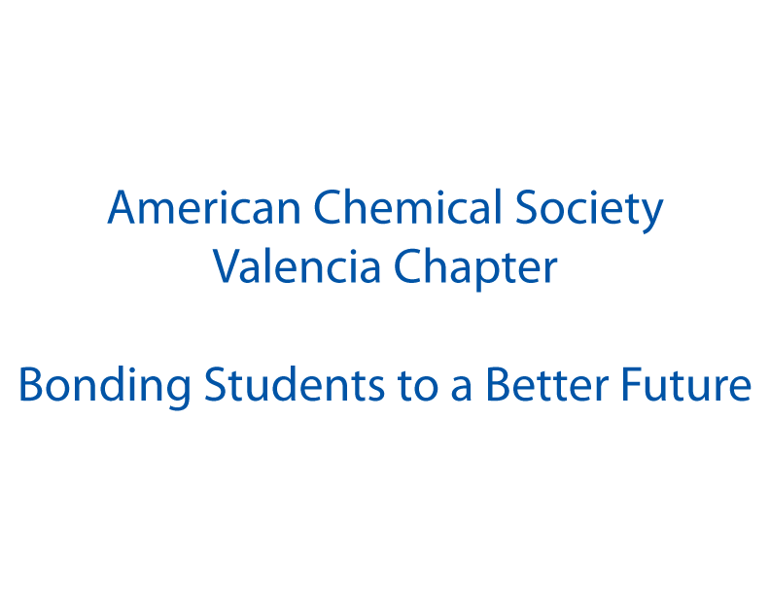
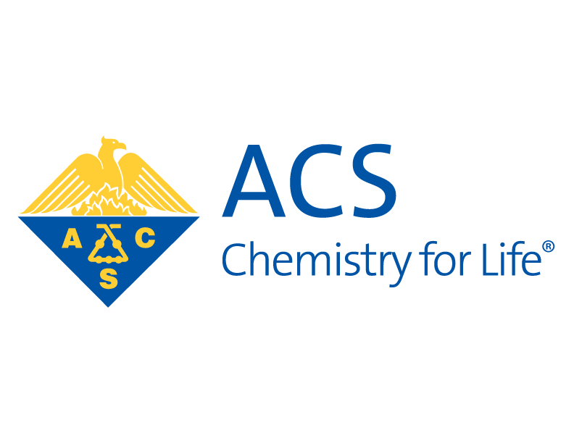

Slide 2
Origin of the ACSVC
Summer 2011
Forwarded email from Dr. Eileen Perez about student chapters of the ACS
Fall 2011
Dr. Diego Diaz agreed to be a co-advisor
Investigation of student interest
$500 Starter Grant for ACS Student Chapters at Two-Year Colleges
Wrote the constitution with ‘founding members’

Slide 3
Student Interest Survey Results
What members wanted from the club:
Community service hours
Letters of recommendation
More knowledge/experience in science
Field trips
Guest speakers
Tutoring in chemistry
Internships/lab experience
Fun experiments
Scholarship help

Slide 5
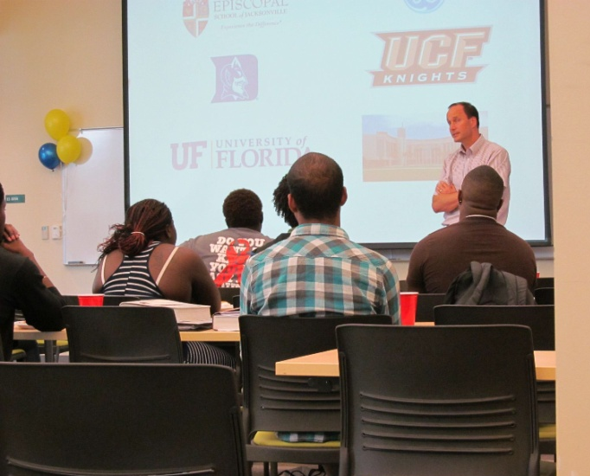
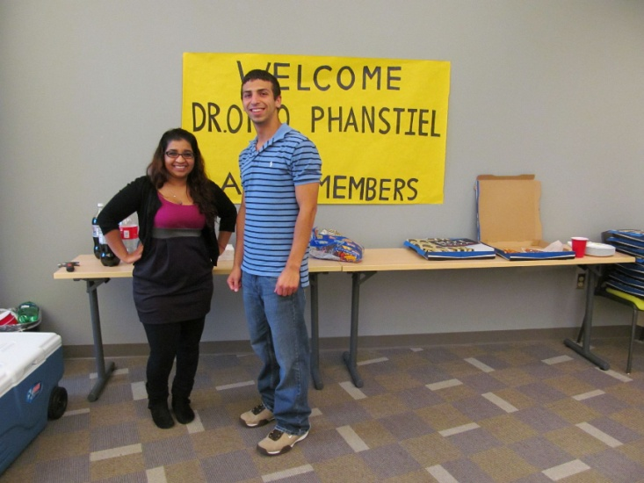
Business Meetings – 8 to 35 attendees

Slide 6
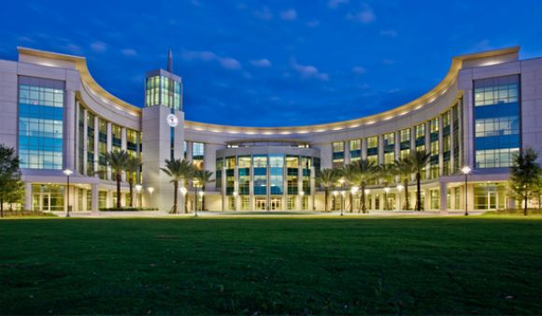
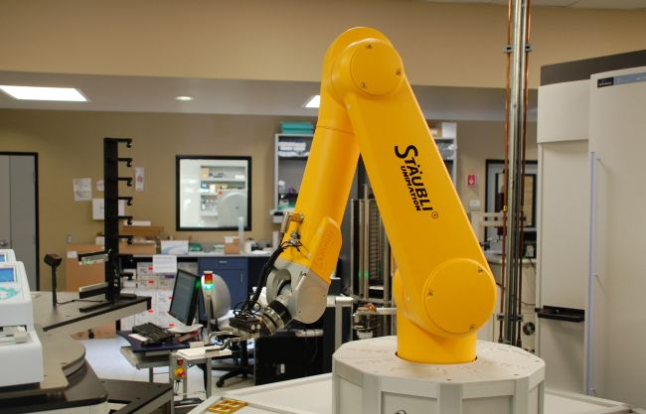
Career Exploration Field Trip: Lake Nona Medical City
UCF College of Medicine
Talk by Robert Larkin, Director of Admissions
Tour of the classrooms, labs, and library
Sanford-Burnham Medical Research Institute
Vignettes from various researchers
Tour of the labs
9 attendees

Slide 7
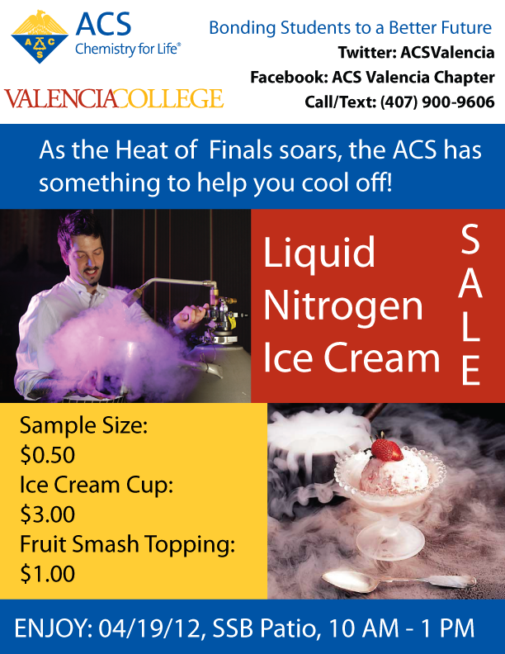
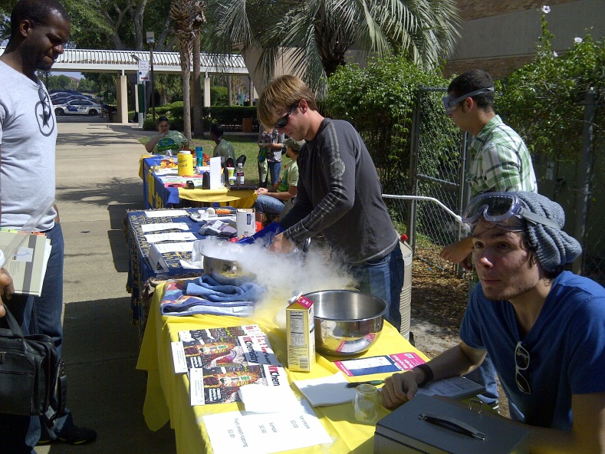
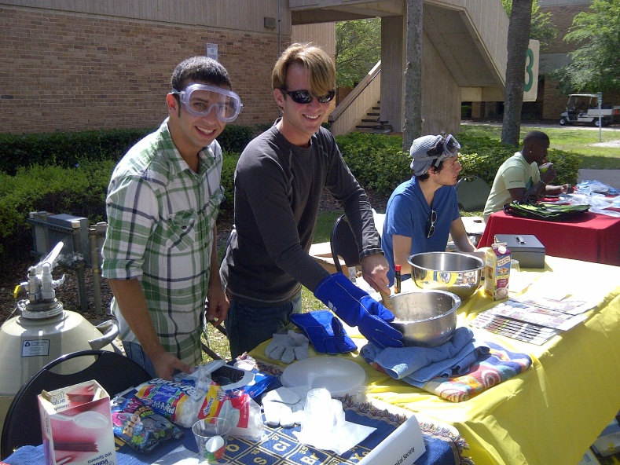
Liquid Nitrogen Fundraiser

Slide 8
ACSVC Challenges
Lack of direct access to students
Low participation from students
High turnover of members/officers
Lack of organization
Officers
ICC/student development

Slide 9
ACSVC Successes
Recognition as official Valencia College club
25 members
8 events in spring 2012
3 business meetings: bringing in speakers from UCF and Siemens Energy, making slime
3 recruitment events with Interclub Council: dry ice experiments, InChemistry magazines, etc.
career exploration field trip to Lake Nona Medical City
liquid nitrogen ice cream fundraiser
Recognition as official ACS chapter
Completion of ACS grant

Slide 10
Check us out!
Atlas Group: American Chemical Society
Facebook: ACS Valencia Chapter
www.acs.org/undergrad and click on “Student Chapters”

